Slide 1
Evolution and Modern Molecular Biology Evidence
Leonard Brand, PhD
Professor of Biology and Paleontology
Department of Earth and Biological Sciences
Loma Linda University

Slide 2
History of scientific advance
Darwin (mid-1800’s)
Molecular biology unknown
Genetics still decades in the future
Neo-Darwinian Synthesis (the Modern Synthesis)
1930’s and 1940’s
Synthesis of population biology, genetics, mathematical biology, and
paleontology
Molecular biology still in the future
Molecular biology
Especially since the 1950’s; rapid growth recently

Slide 3
What do we know now that we didn’t know a few decades ago?
Recent developments – last 5 to 10 years
Rapid and spectacular advance in genetics and molecular biology

Slide 4
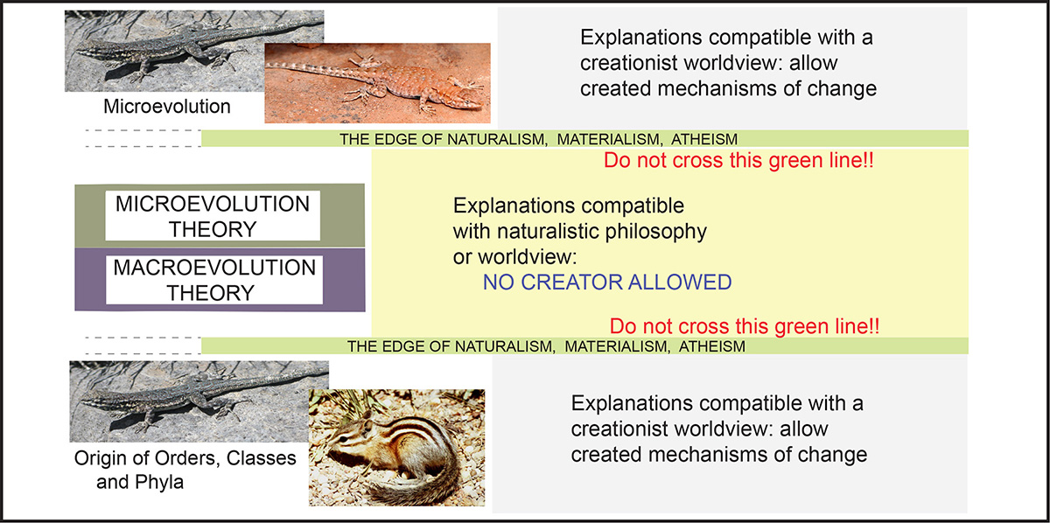
Explanation of figures used in this presentation: the role of worldviews

Slide 5
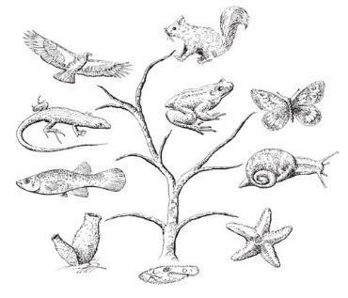
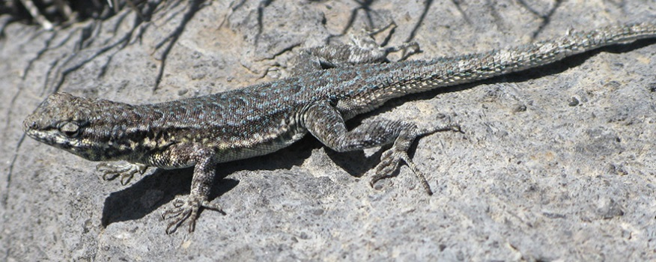
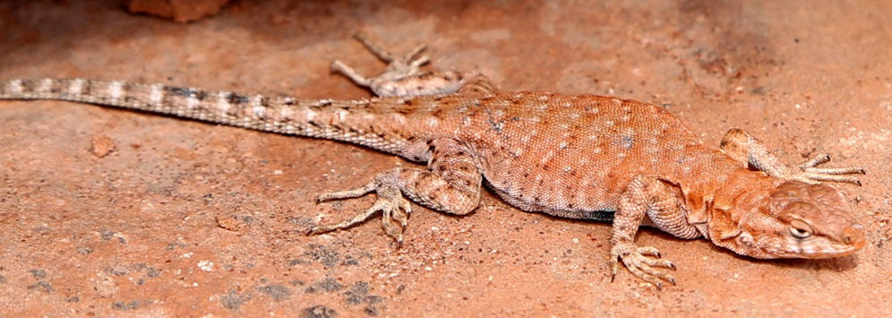
DEFINITIONS
Microevolution
Adaptation
Changes within a species
Macroevolution
Evolution of new major groups
of organisms – Orders, Classes,
Phyla
The same lizard species: different environments

Slide 6

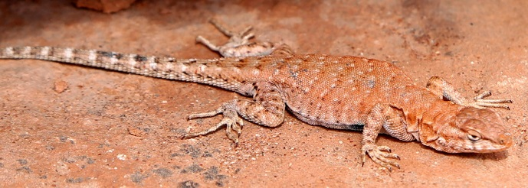
Microevolution
Adaptation
Changes within a species
Macroevolution
Evolution of new major groups
of organisms – Orders, Classes,
Phyla
Microevolution is compatible with creation – it is adaptations since the creation
Macroevolution is contrary to biblical creation

Slide 7
How does microevolution work? What is the process?
Accepted evolution theory:
1. Random mutations
2. Natural selection
These two concepts are the core of Neo-Darwinism

Slide 8


In Darwinian theory, the process must be random
Nowhere in the process can there be foresight
of what would be beneficial to the organism
Only natural selection (a naturalistic process)
determines which random change will succeed

Slide 9
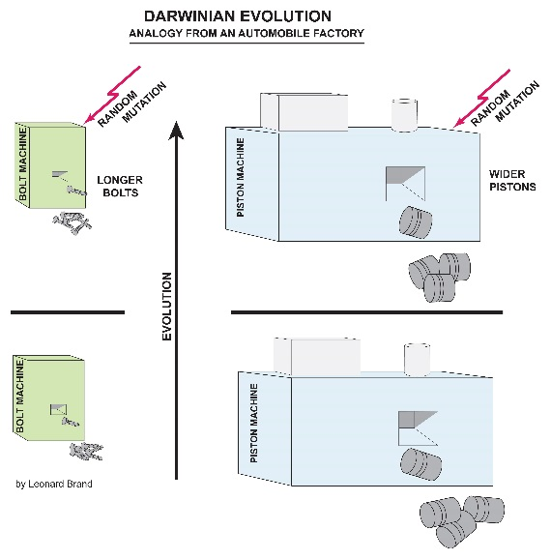
In Darwinian theory, the process must be random
Nowhere in the process can there be foresight
of what would be beneficial to the organism
Foresight would imply creation or
intelligent design
An analogy of evolution

Slide 10
Problems for Darwinian theory of random mutation and natural selection
Problems are rapidly increasing, especially from advances in molecular biology

Slide 11
Problem # 1 – what is junk DNA?
About 98% of human DNA is called “silent DNA” because it does not produce protein
This has been interpreted as junk DNA – functionless remnants of evolution
This DNA is needed as a resource for making new genes

Slide 12
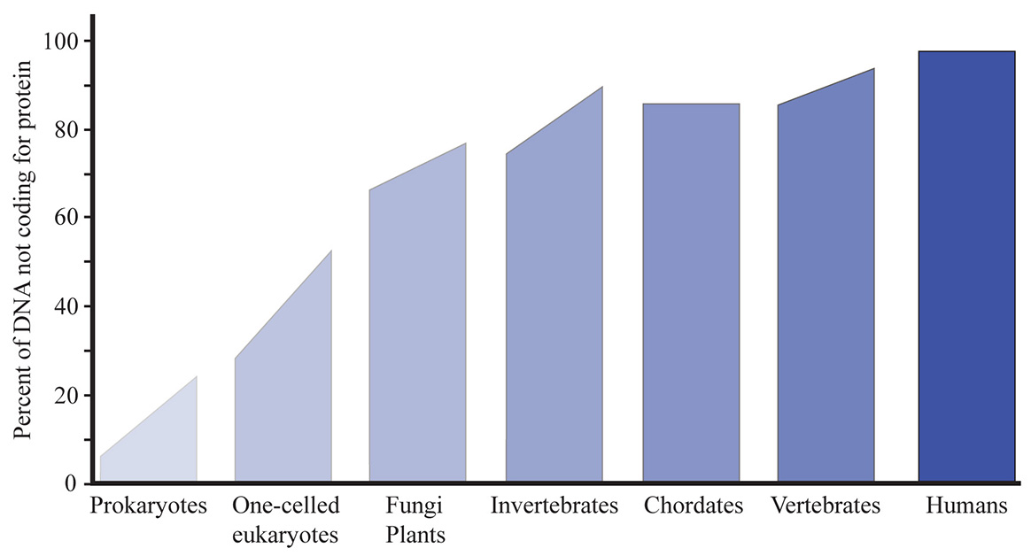
Problem: the percent of “junk DNA” is proportional to organism complexity

Slide 13
The percent of “junk DNA” is proportional to organism complexity
Thus the “junk DNA” seems to be involved in producing that complexity

Slide 14
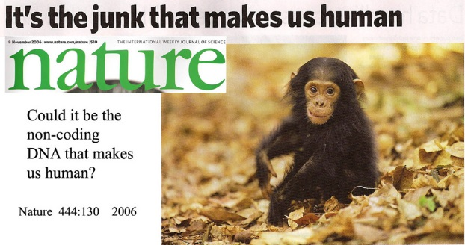
Former: Junk DNA – functionless genetic remnants
About 98% of human DNA is junk with no function –
remnants of evolutionary history
Current: Serious challenges to junk DNA

Slide 15
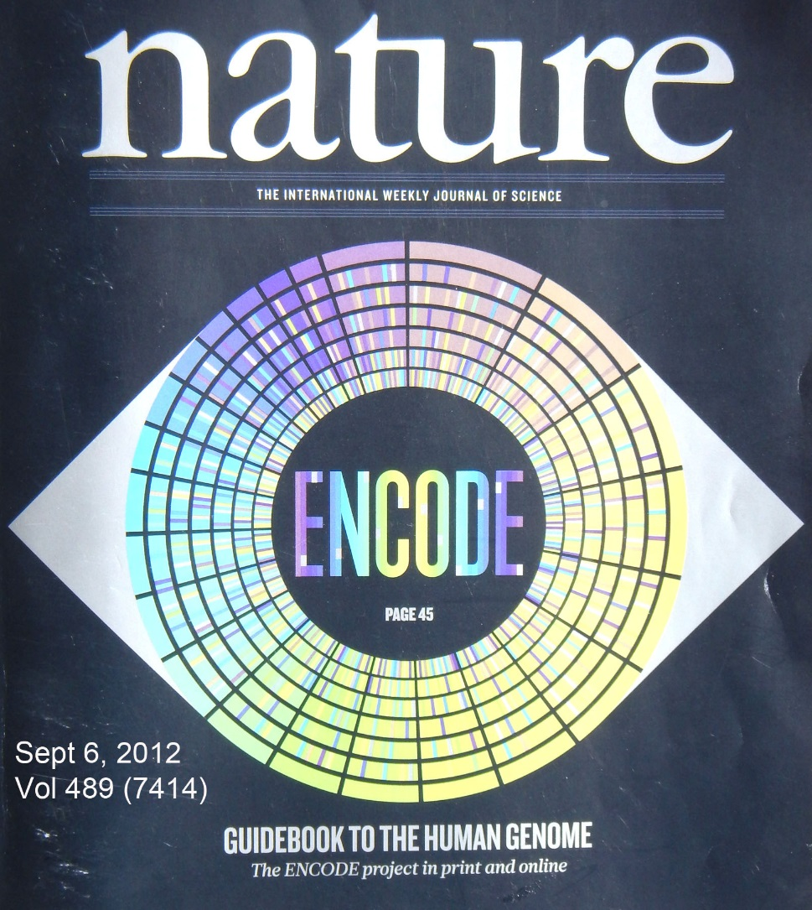
September, 2012
Results of the massive Encode Project published
Nature 489 (7414): 45-113, September 6, 2012.
All or most “junk DNA” is regulatory DNA, controlling the protein-
coding DNA

Slide 16
“Junk DNA” is no longer even a useful concept
The supposed junk DNA controls whether our protein-coding DNA will make a human, a chimpanzee, or a mouse

Slide 17
Problem # 2
Evidence for the tree of life (common ancestry of all genes and organisms) – is facing serious setbacks

Slide 18
Darwinian understanding of macroevolution requires that all new features arise by a long, gradual series of small changes
The tree of life is claimed to be a record of this series of changes

Slide 19
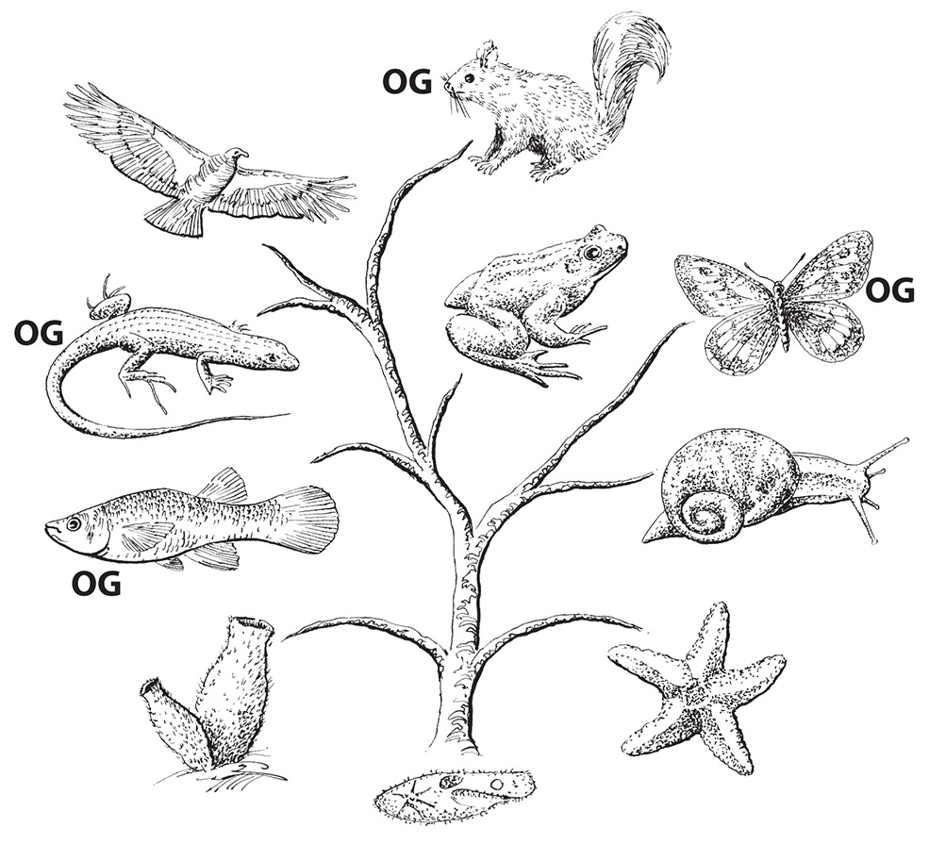
Problem: ORFan genes (orphan genes) – genes that seem to just appear with no evolutionary ancestry
10 – 20% of genes are orphan genes
1,000 of these in humans alone
Some are very important; one
is responsible for the large human brain
(OG – orphan gene)

Slide 20
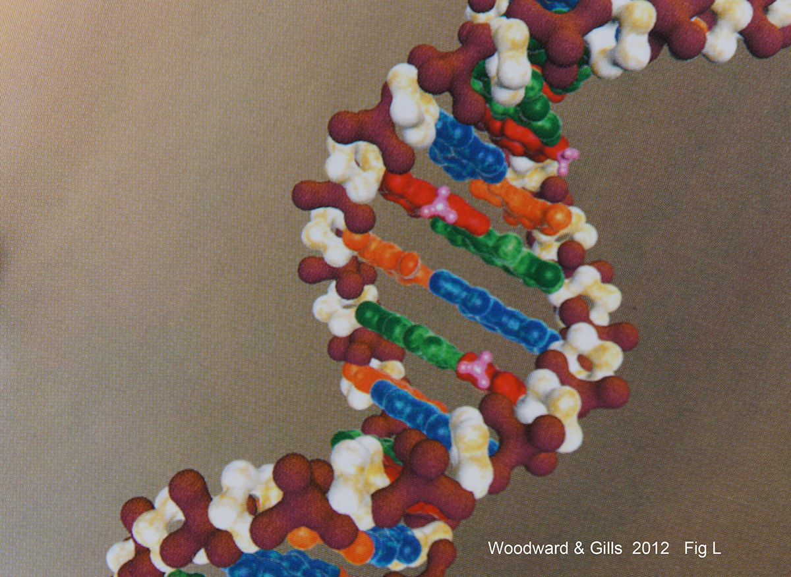
Problem # 3: Epigenetics
Epigenetics is a management system that determines how to use the DNA
Sensors in the cell detect environmental factors
Places chemical tags on the DNA
(the little pink tags)
They turn genes on and off, without
changing the information in DNA

Slide 21
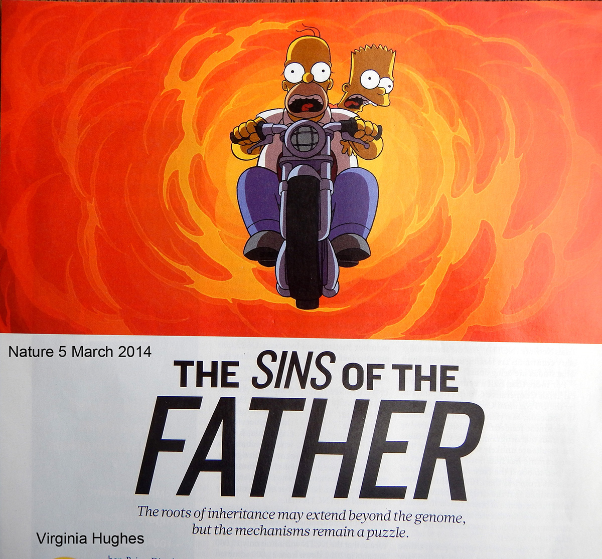
Epigenetics
Epigenetic effects can last for several generations

Slide 22
Example:
Blind cave fish – how did they become blind?
Old explanation – random mutations destroyed sight

Slide 23
Example:
Blind cave fish – how did they become blind?
Old explanation – random mutations destroyed sight
New explanation – epigenetics
Their eye genes are intact, but have been turned off
No changes in the DNA

Slide 24
Epigenetics is a problem for Darwinism, because:
Epigenetic environmental influences initiate changes that are:
Beneficial
Inheritable
Non-random

Slide 25
Epigenetics is a problem for Darwinism, because:
Epigenetic environmental influences initiate changes that are:
Beneficial
Inheritable
Non-random
How can this happen unless there is, somehow, intelligent
awareness behind the design of this system?

Slide 26
Problem # 4: Other new insights from molecular biology
Darwinian random mutations and natural selection don’t work
New genetic information must arise some other way

Slide 27
“the Modern Evolutionary Synthesis included an ad hoc assumption about the random nature of hereditary variation.” Shapiro p. 142
“It requires great faith to believe that a process of random, accidental genome change could serve this function” (adaptation). Shapiro p. 134
“hereditary change results from . . . active cell processes rather than a series of random accidents.” Shapiro p. 129
Natural genetic engineering – “cells are now reasonably seen to operate teleologically (with purpose): their goals are survival, growth, and reproduction.” Shapiro p. 137
Shapiro. Evolution: A View from the 21st Century.

Slide 28
How do these “new evolutionists” explain the evolution process?
Active cell processes - not random accidents Shapiro p. 129
Natural genetic engineering – cells have goals - survival, growth, and reproduction.” Shapiro p. 137
The complex biochemistry in the cell “decides” how to interpret the DNA.
Random mutations are not the source of genetic change

Slide 29
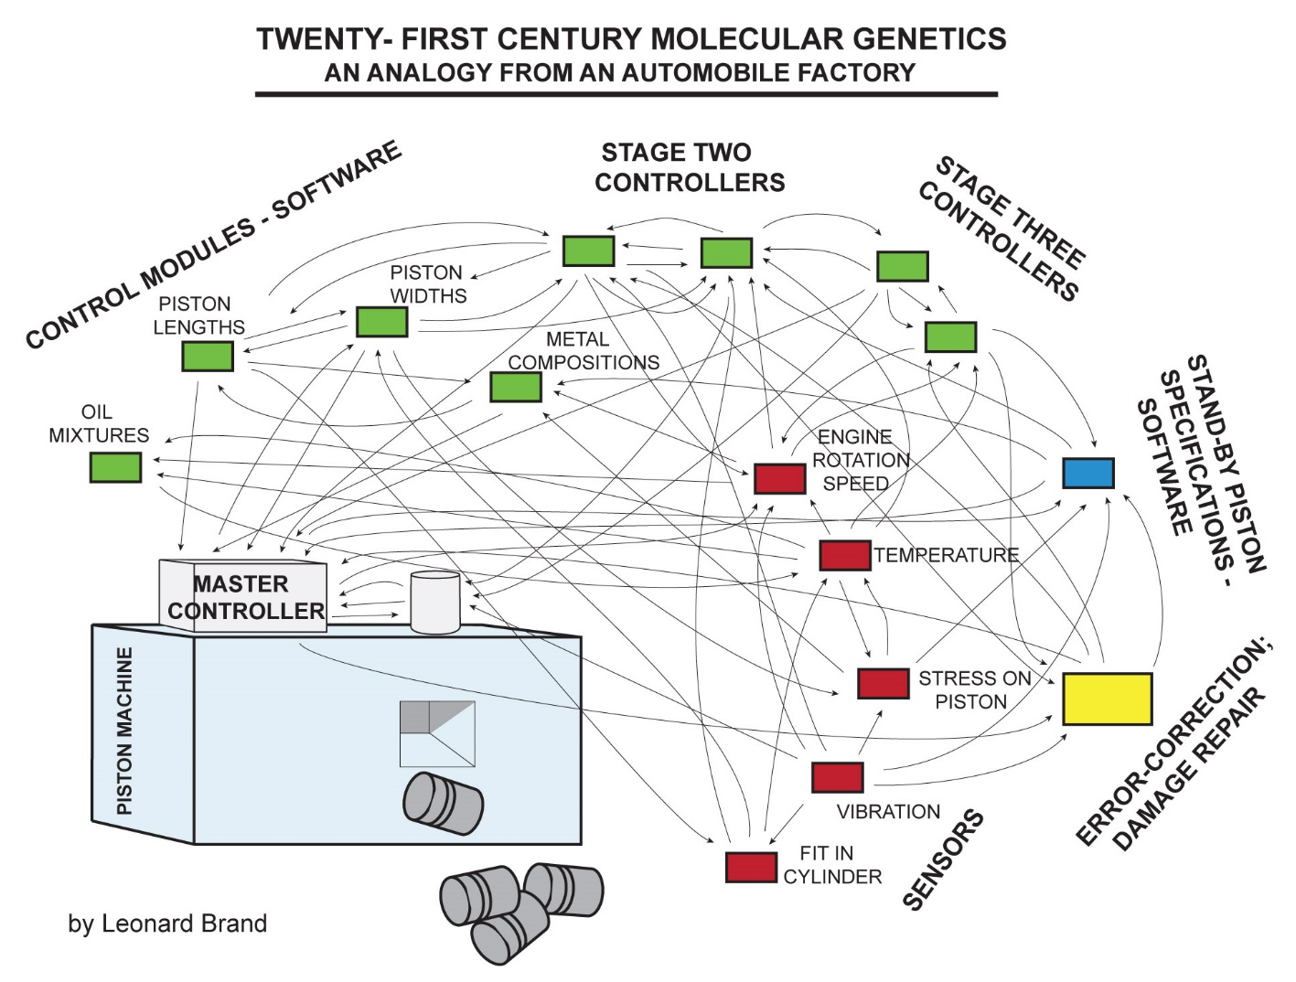
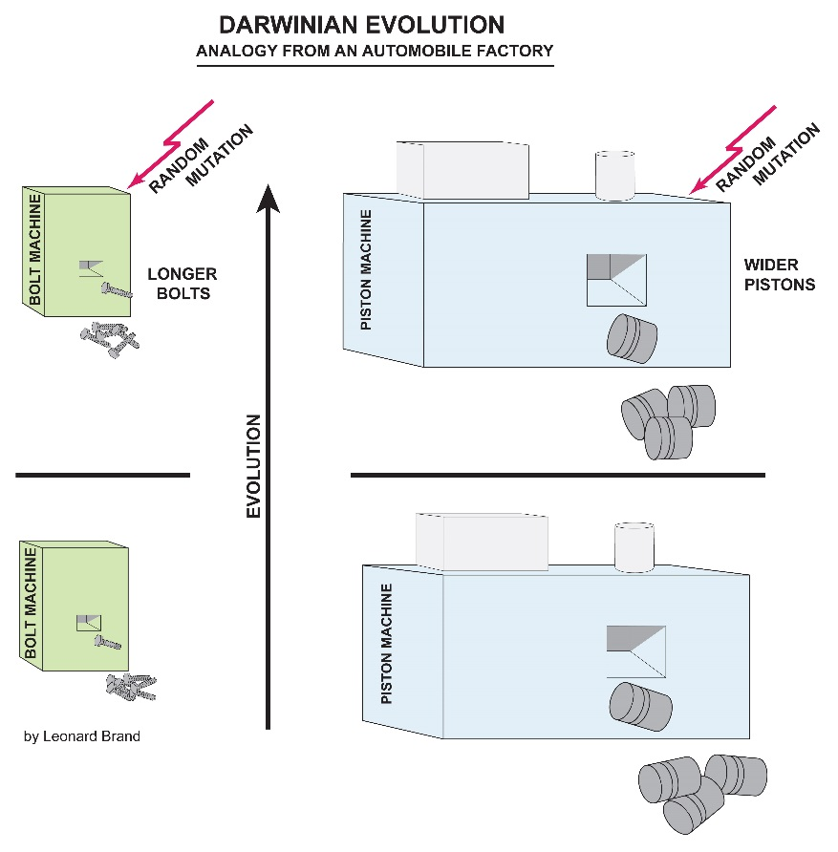
An analogy to illustrate these new insights in molecular genetics

Slide 30
Organisms have “stand-by” genetic information
Potential for change

Slide 31
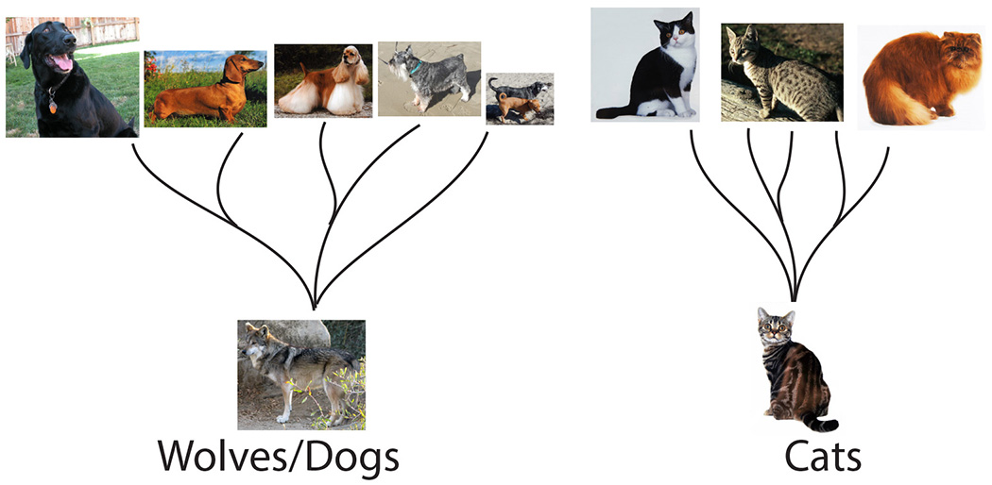
Stand-by genetic information – example: genetic variability in dogs

Slide 32
Dogs were created with enormous genetic variability: Cats have much less

Slide 33
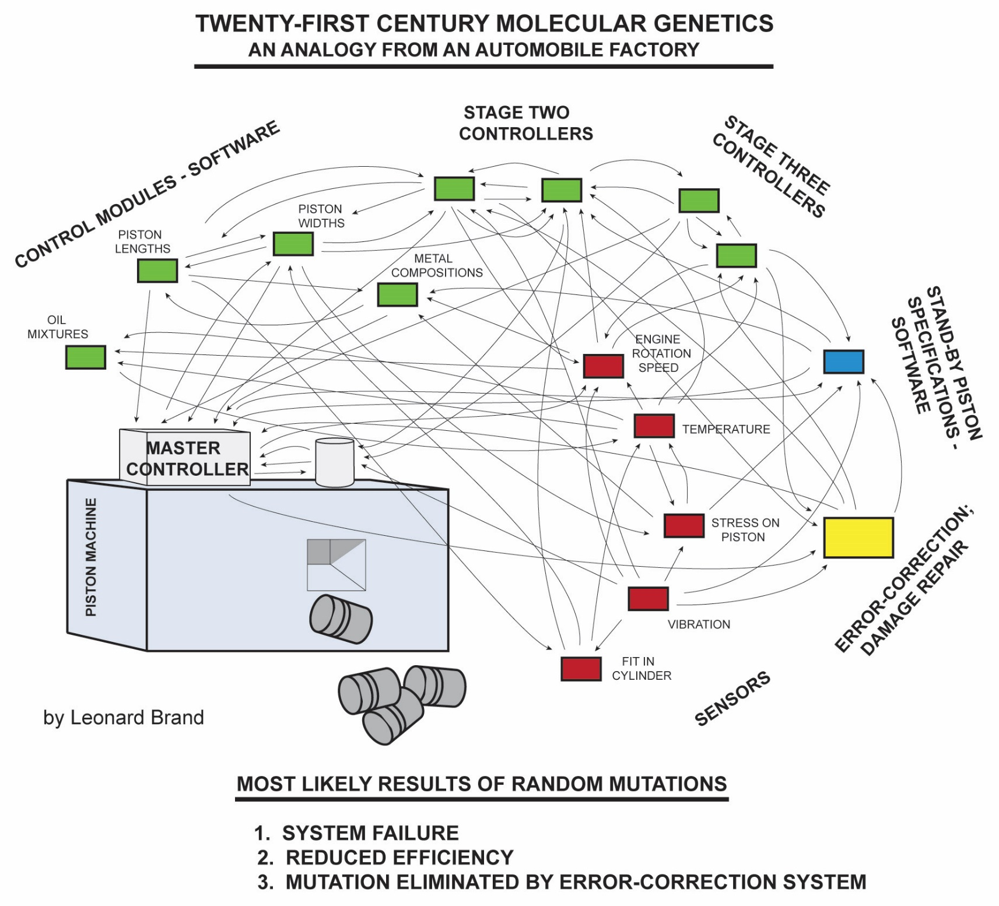
If random mutations (random damage) do occur, what is the most likely result?

Slide 34
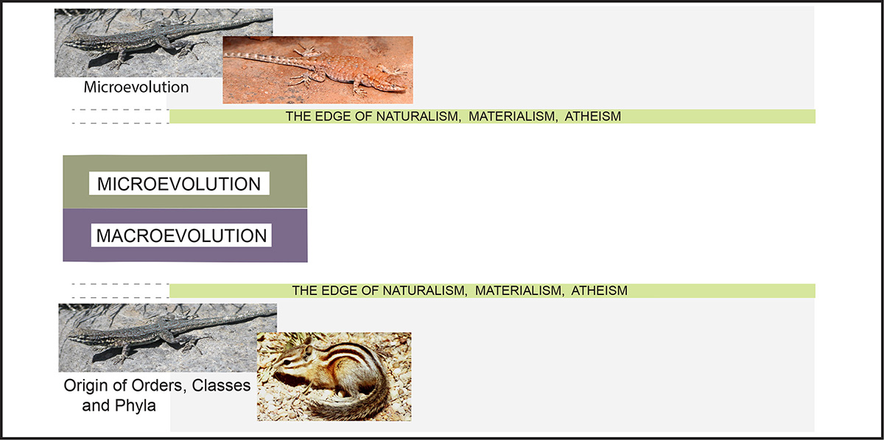
Macroevolution: is it just an accumulation of microevolution over time?

Slide 35
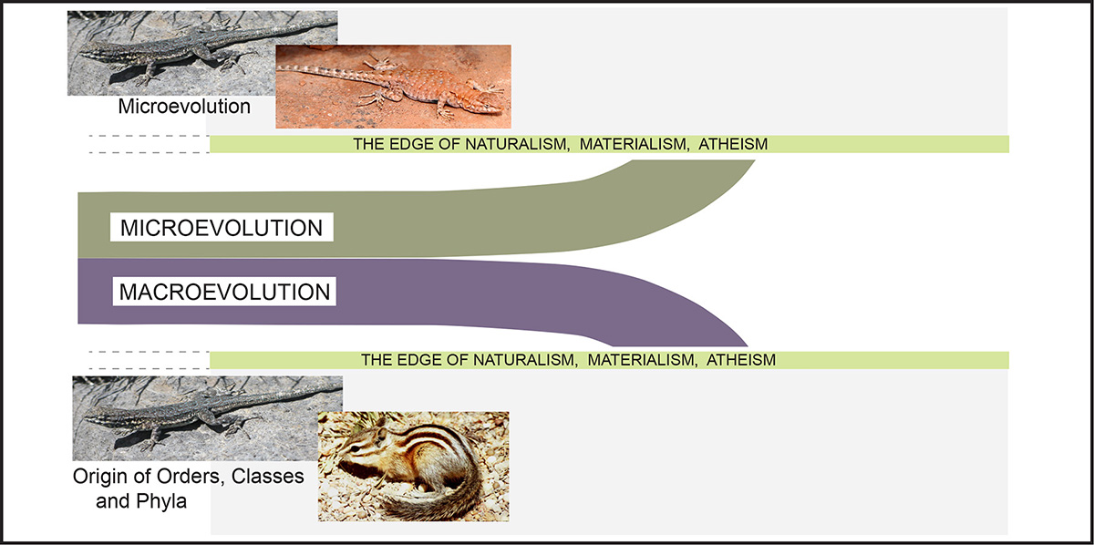
New molecular evidence is pushing micro and macroevolution apart.
Macroevolution is a different process:
It is not just accumulated microevolution over time

Slide 36
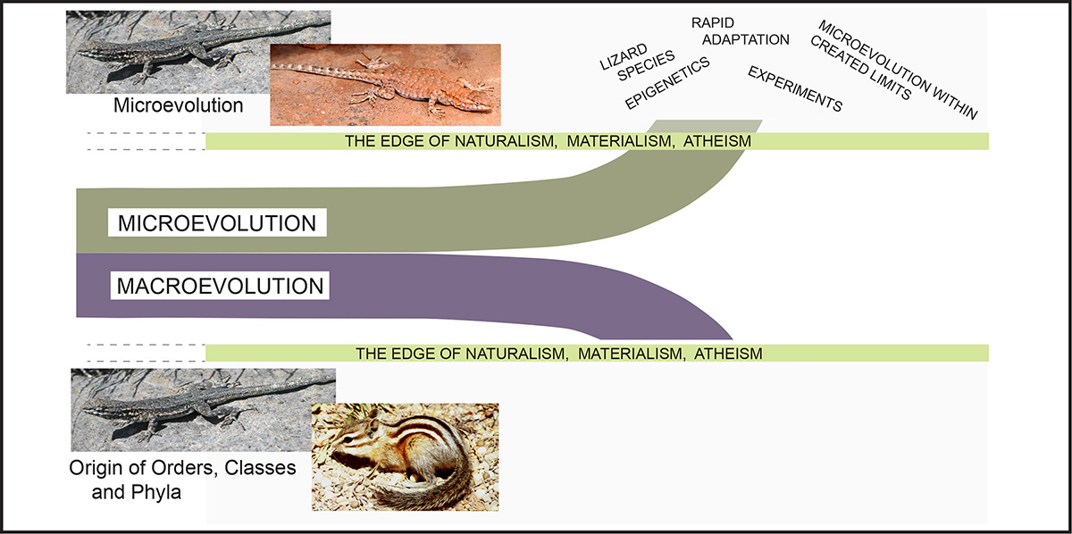
Problem # 5: Micro and macroevolution challenge naturalism
Microevolution: Rapid, and more than a naturalistic processes

Slide 37

And, macroevolution theory is collapsing

Slide 38




How are evolutionary scientists responding to these challenges?
Orphan genes
Failure of Darwinism
No junk DNA
Epigenetics

Slide 39
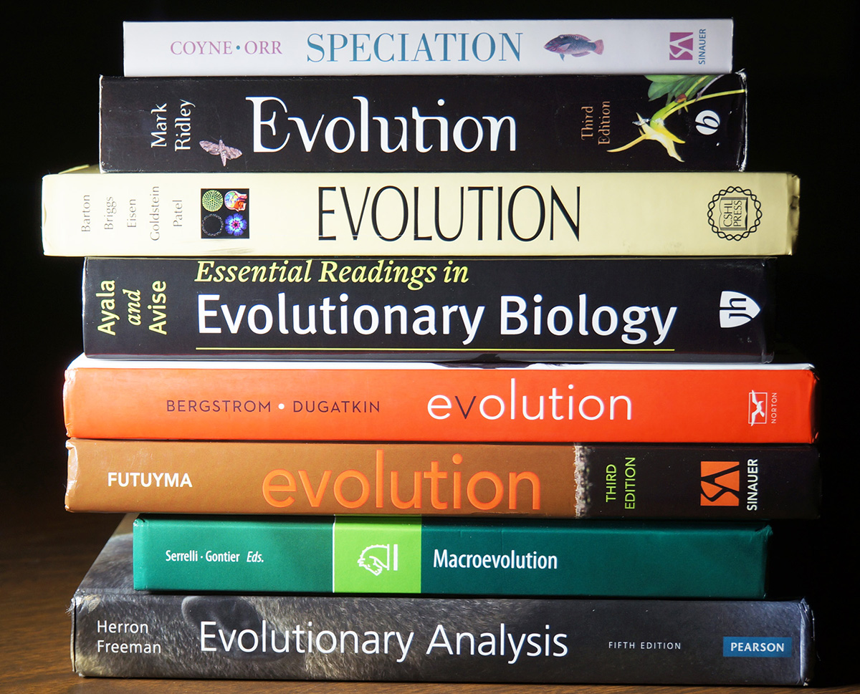
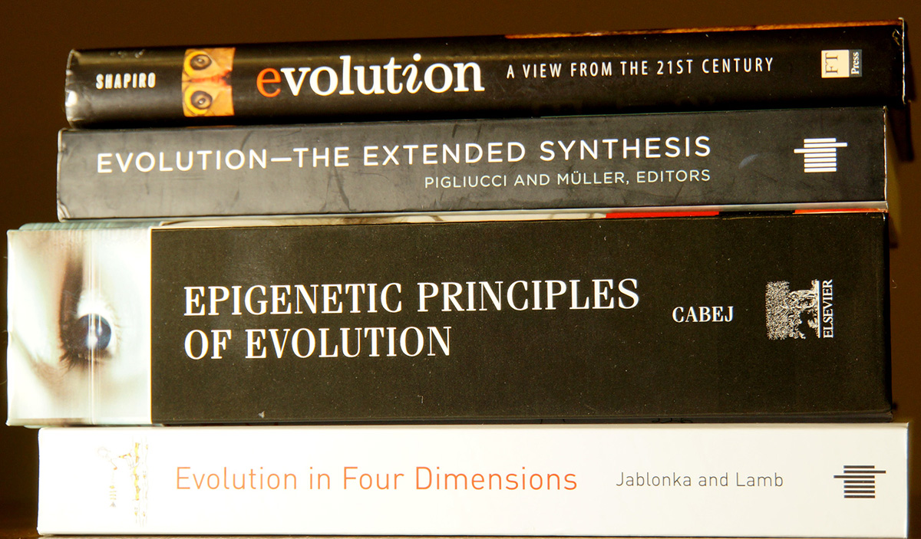
Two groups of current evolution textbooks
Epigenetics minimized or ignored
Orphan genes not mentioned
Epigenetics – the source of a new evolution theory

Slide 40
Macroevolution is facing increasingly serious challenges
Eminent evolutionists, primarily molecular biologists, are raising those challenges and rejecting Darwinian theory
So –
Why do evolutionary biologists seem to be more committed to their theory than ever?

Slide 41
Macroevolution is facing increasingly serious challenges
Eminent evolutionists, primarily molecular biologists, are raising those challenges and rejecting Darwinian theory
So –
Why do evolutionary biologists seem to be more committed to their theory than ever?
It is because of philosophy, not evidence

Slide 42
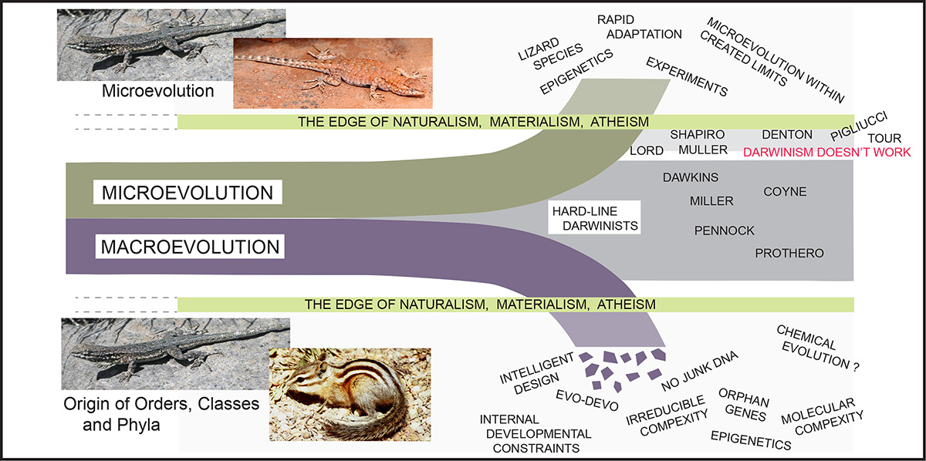
Darwinian theory is collapsing, largely from the molecular challenges.
Hard-line Darwinists are relying on commitment to their naturalistic philosophy (worldview)

Slide 43
Conclusions
Darwinian theory of evolution through random mutations and natural selection is facing deadly challenges
There is a growing conflict within science, between hard-line Darwinists and the “new evolutionists” who recognize the collapse of Darwinism
Creationists have increasing reasons to be confident of the literal creation of life forms
God loves all persons.
Be respectful of those we disagree with, even though we reject their beliefs about origins

